Slide 1
Kickstarter Project
Amani Yusuf
15 April 2025

Slide 2
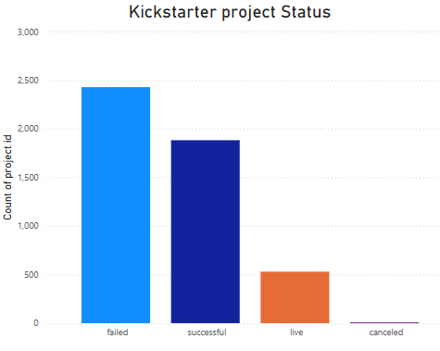
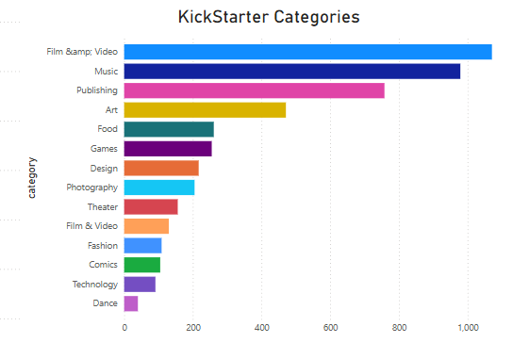
Kickstart Project Overview
Film & Video, Music, and Publishing are the categories that attract the most attention. These creative projects mainly rely on innovation and originality
50% of the projects are successfully funded
40% are failed

Slide 3
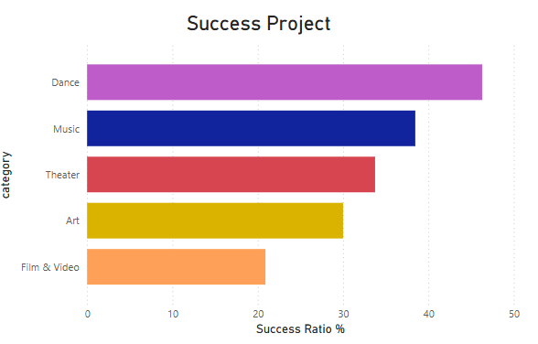
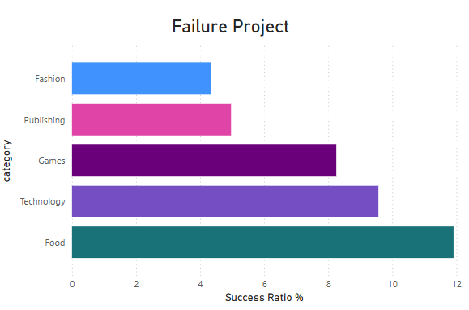
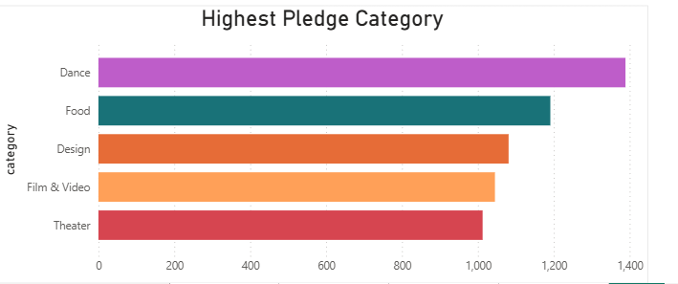
Success Vs Failure Project Category
Dance is most likely category to get funded
Dance is highest Pledged category
Fashion, Publishing, Games have less chance of success

Slide 4
Success Vs Failure Project Category
Dance is most likely category to get funded
Dance is highest Pledged category
Fashion, Publishing, Games have less chance of success
Dance
Food
Design

Slide 5
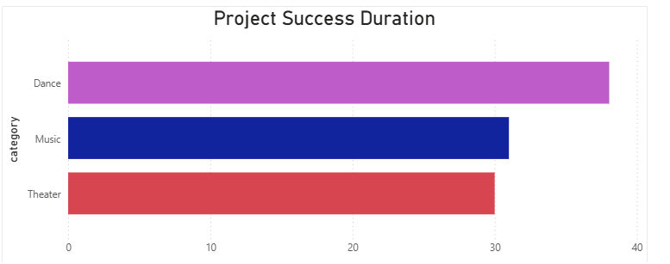
Drivers for Successful Project
Project Duration
Optimal Project Duration is 30 Days or less
Projects that run for approximately one month maintain the best balance between urgency and backer engagement.
Most categories get high pledged are Dance, Food and Design

Slide 6
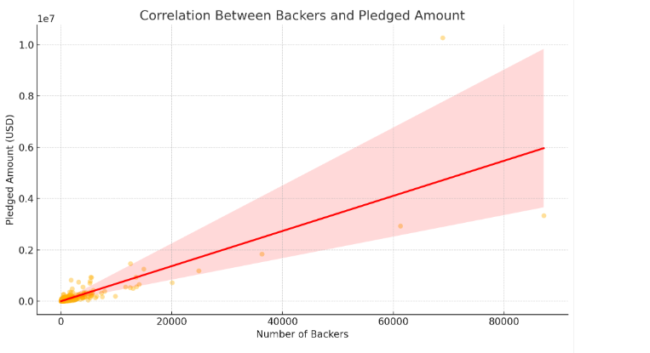
Machine Learning
For every additional backer, the pledged amount increases by approximately 68%
68.8% of the variation in Pledged amount
pledged=68.45×backers+227.37

Slide 7
Recommendation
Category
Project Duration
Project with High success Rate :
Music
Dance
Theater
Optimal Project Duration to be 30 days or less

